Slide 1
Shakespeare’s
Fact or Fiction

Slide 2
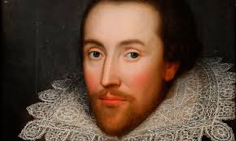
Shakespeare

Slide 3
Shakespeare Fact or Fiction
William Shakespeare was born on Oct. 23 1564, St George’s Day (St. George is the patron saint of England.)

Slide 4
Shakespeare Fact or Fiction
-Answer: Possible FACT -21, 22, or 23?
-This date was selected
- Fuse him further into the mythical/ Godlike figure of England.

Slide 5
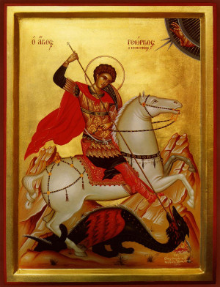
St. George

Slide 6
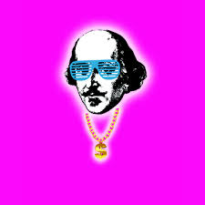
Shakespeare as God or mythical figure for England

Slide 7
Shakespeare Fact or Fiction
William Shakespeare’s body of work is admired by all playwrights.

Slide 8
Shakespeare Fact or Fiction
-Answer: FICTION
Voltaire said that “Shakespeare is a drunken savage with some imagination whose plays can please only in London and Canada.”

Slide 9
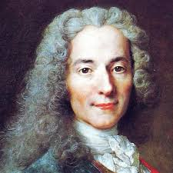
Voltaire

Slide 10
Shakespeare Fact or Fiction
-Answer: FICTION
Darwin (admittedly not a playwright) wrote, “I have tried lately to read Shakespeare, and found it so intolerably dull that it nauseated me.”

Slide 11
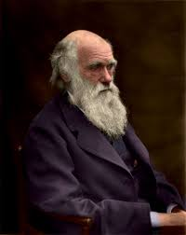
Darwin

Slide 12
Shakespeare Fact or Fiction
-FICTION
Poet, Robert Bridges said, “Shakespeare should not be put into the hands of the young without the warning that the foolish things in his plays were written to please the foolish, the filthy for the filthy, and the brutal for the brutal.”

Slide 13
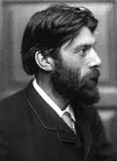
Robert Bridges

Slide 14
Shakespeare Fact or Fiction
-William Shakespeare wrote 37 plays and 154 sonnets.

Slide 15
Shakespeare Fact or Fiction
Answer: It’s complicated
Shakespeare’s name has been attached to at least that many plays.
-There could be more or less -Different ideas of authorship.

Slide 16
Shakespeare Fact or Fiction
-Each actor in the play receives their own lines
-Few of his works were published during his lifetime.
-There is no physical evidence that he was paid
-Drama was often collaborative and changed

Slide 17
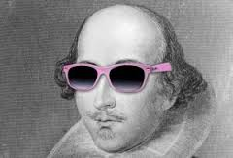
Shakespeare the Actor

Slide 18
Shakespeare Fact or Fiction
-154 is the number of collected sonnets
-there are many more that exist within his plays. (abab cdcd efef gg)

Slide 19
Shakespeare Fact or Fiction
William Shakespeare was married to an older woman, Anne Hathaway in 1582. She was eight or nine years older, and three months pregnant.

Slide 20
Shakespeare Fact or Fiction
Answer: Fact
-What is unclear is if it was a forced or shotgun wedding.

Slide 21
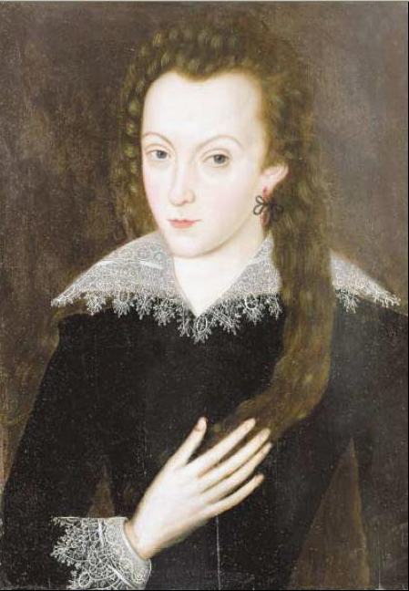
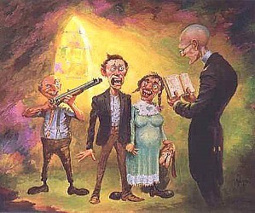
Anne Hathaway

Slide 22
Shakespeare Fact or Fiction
Evidence for shotgun wedding
“second best bed” (Will’s will)
Spent most of his life in London, away from her in Stratford
Affair?

Slide 23
Shakespeare Fact or Fiction
Evidence against shotgun wedding
Retired in Stratford
Other reasons for the bed
Affair spelling error?
Three children, one died

Slide 24
Shakespeare Fact or Fiction
William Shakespeare was an Englishman who grew up in an illiterate lower-class household of a glove maker.

Slide 25
Shakespeare Fact or Fiction
Answer: Fact, A man named William Shakespeare did in fact grow up in an illiterate household.
-But, scholars question a poor man’s ability to have created his body of works about Kings.
-Merit and not birth.

Slide 26
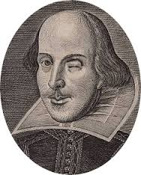
We may never know?

Slide 27
no one knows

Slide 28
People have their own motives to prove or disprove his legitimacy.

Slide 29
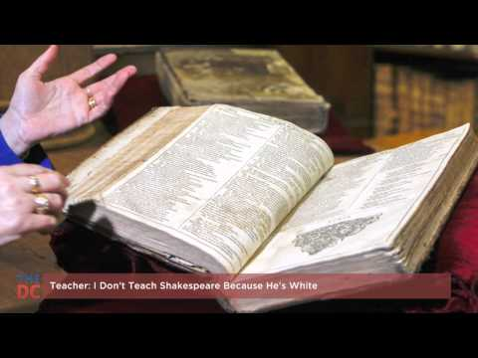
Do you enjoy his work?
Is he important?
If so, why?
Is it worth studying?

